Slide 1


SAFETYKIDS PROGRAM
Keeping children safe from abduction, violence, and exploitation! FEATURING CHARLIE CHECK FIRST

Slide 2
Be a Safety Kid Program
Is a fun, motivating, and effective way to teach personal safety to children.
Children need to learn how to make wise choices and to be empowered to object to or avoid situations that are dangerous or harmful to their bodies.
A majority of the children who are victimized know the perpetrator; therefore, the concept of stranger danger is ineffective! It puts children in a position of feeling secure just because they think they know the person. This, in fact, makes them vulnerable and may lead to victimization.
Charlie Check-First replaces that concept and has been readily endorsed by educators and law enforcement.

Slide 3
SAFETY EDUCATION – WHY TEACH IT?
Kids are not taught at home
Prepares children; gives them a plan
Parents don’t understand the need or importance
Empower children with knowledge
Children will not always be supervised
High level of sex offenders

Slide 4



Our Mascots have been designed to enhance the teachable moments, be memorable and fun.
Charlie Check-First teaches children to: “Check First before you go anywhere with anyone.”
KC Koala reminds children that: “Kind and Caring is the way to be!”
Ima S.T.A.R. says: “Students Together Are Responsible!”

Slide 5
WHO PRESENTS THE MATERIAL?
This curriculum has effectively been presented in many different ways, by many different professionals:
Classroom teachers present it as independent lessons.
Health teachers present it as part of the study on safety.
Guidance counselors present selected topics to the classrooms.
Public safety present the lessons in the classroom.
Teamwork is used (police officers + guidance counselors, etc.)
Self-defense instructors utilize the curriculum as a passive alternative.
Day cares, religious organizations and non-profits incorporate the curriculum concepts into other lessons or programs.

Slide 6


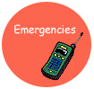



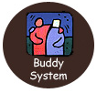
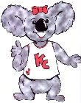

The curriculum is divided into core subjects which are age appropriate and designed with easy to follow script. Each core subject has follow-up activities designed to reinforce the concept of the lesson. These activities address Gardner’s “Multiple Intelligence Theory.”
 | LURES |  | SAFETY PERSON
 | EMERGENCIES |  | POWER NO
 | HOME ALONE |  | STAND TOGETHER, ACT RESPONSIBLY
 | BUDDY SYSTEM |  | KIND & CARING
 | OBERVATIONS

Slide 7

Gardner’s “Multiple Intelligence Theory.”
The activities at the end of each topic are designed to reinforce the concepts of the lesson. It is most beneficial to do activities periodically, so that the safety tips are reinforced throughout the year.
Children have the capacity to learn in different ways. What works best for one child may not be effective for another. Therefore, these activities address Gardner’s “Multiple Intelligence Theory.”
The reinforcement activities are categorized in the following manner:
Intrapersonal
Interpersonal
Logical/Mathematical
Verbal/Linguistic
Musical/rhythmic
Visual/Spatial
Body/Kinesthetic
The activities are geared for a variety of age groups so that you can select or adapt them to meet the mental maturity of your students.

Slide 8
SAFETY KIDS PROGRAM
HOW TO USE CURRICULUM

Slide 9
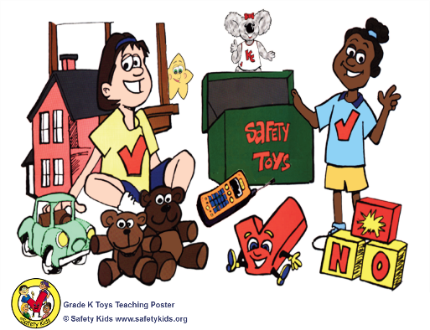
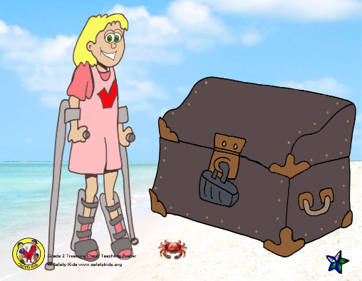
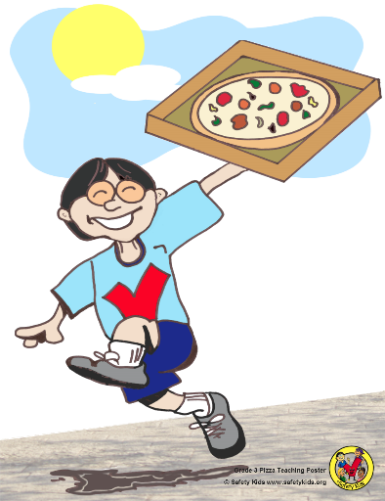
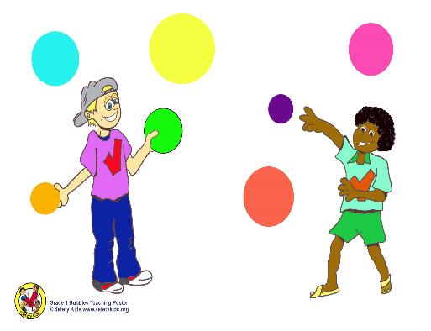
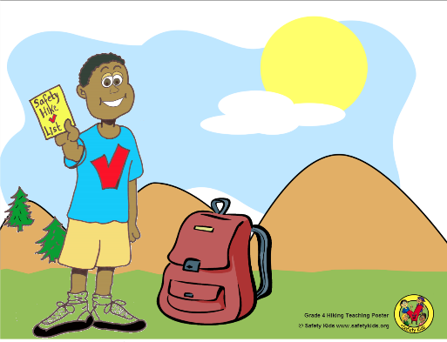
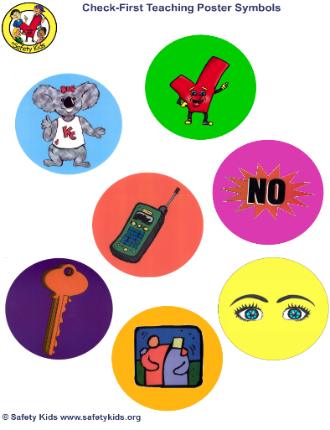
GRADE LEVEL
TEACHING POSTERS
KINDERGARTEN
2ND GRADE
3RD GRADE
Each grade level except for grade 5 has an associated poster to help teach the lessons. Although, the lessons can be taught without the posters. The teaching symbols can be cut out and laminated. Use Velcro or magnets to apply to posters. Be creative!
1ST GRADE
4TH GRADE
SYMBOLS

Slide 10
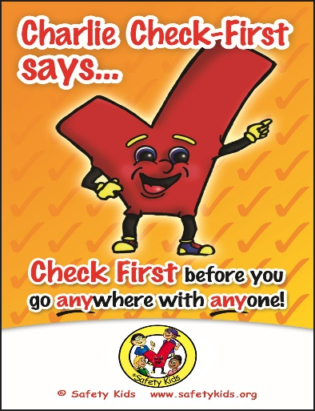


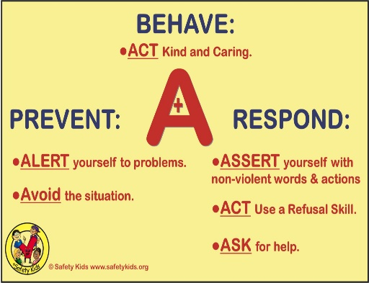
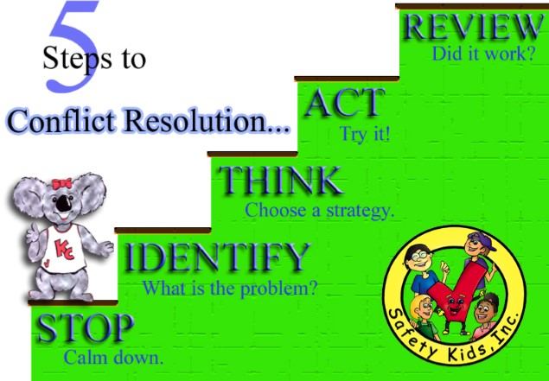

PROGRAM
POSTERS
Additional posters will aid in the delivery of the lessons in the curriculum. The lessons are simple and easy!

Slide 11
SAFETY KIDS CURRICULUM CONTENT
Each lesson will follow the same format no matter the grade level with the exception of mini lessons.
Lessons - Easy to follow outline. Provides verbiage which can be read to the audience. Identifies which props to use and who to involve the students.
Introduction – Explains the lesson.
Materials – Items need to present the lesson.
Objectives – What the students will learn, the goal or take-a-way.
Appendix - A variety of handouts and may include letters to parents, follow-up to lessons, certificates, and much more.

Slide 12
STARTING A SAFETY KIDS LESSON
Review the entire lesson to include: Introduction, lesson, and appendix.
Decide if you will utilize the pre and post test.
Gather the props needed to teach the lesson you have selected.

Slide 13
EXECUTING THE LESSON
The Pre K/Kindergarten lesson [CCF-1-K] is used for this demo.
Prepare your materials in the location the lesson will be taught to include:
Decide which topics you plan to teach for your session and have the corresponding symbol cards ready.
Toy chest poster, poster symbols [circles], and any props such as buddy bears or a poster of Charlie Check First.
Display the Toy Chest poster. Discuss the story behind the Safety Kid on the poster. [Follow script in lesson: “These kids are Safety Kids and they love to play with their safety toys.”
Remove a symbol card and discuss that topic.
For Example: If you selected the Charlie Symbol Card as the lesson, “Who can come up to the poster and point to a funny, little, red toy? He is a special friend of mine and I have him with me today. You can then display the Charlie Check First Poster Symbol. or Charlie poster.

Slide 14
WHEN TO USE CURRICULUM
Along with its effectiveness, the beauty of this program is its simplicity and flexibility. The structure is comprised of modular lessons, and they may be presented in three easy ways. With one exception, they may be taught in any order.
“Check First” is the most important topic and should be taught first.
1. Present one or two individual topics in a session, followed by a reinforcement activity. This is the most beneficial teaching method and is ideal for the classroom teacher who can use the lessons, worksheets, and the reinforcement activities periodically through-out the year. Lessons and reinforcement activities should be spaced out to allow for gradual and consistent learning.
2. Present a general lesson that briefly covers many or all topics. Choose the topics that are most important for you and the students. This often works best for the law enforcement officer or crime prevention practitioner who has limited time in the classroom. Ask the classroom teacher to follow up with reinforcement activities and worksheets.
3. Mini-Lessons – are short lessons which only require a few minutes to teach. These are great for time fillers in the classroom, after school programs or the Law Enforcement Officer who only has a short time in the classroom or community event.
The following are examples of Mini-Lessons: How to describe a person or vehicle; license plate, people or vehicle flash cards.

Slide 15
HOW TO EVALUATE THE PROGRAM
The Pre/Post Evaluation is located in the introduction pages [CCF-0] for each grade level
Give your students the Pre/Post Evaluation prior to beginning the material. Read the questions for those students who need that assistance. Sometimes there are no right and wrong answers; it is mainly a question of what they perceive.
Give the same test to students after completing the lessons. Was there a change in their thinking? Do they now realize the safest response to a variety of situations?
The Pre/Post Evaluation may assist you in justifying the usage of this program in your teachings. It is also helpful in documenting the programs effectiveness and obtaining additional program licenses for others to use the program.

Slide 16
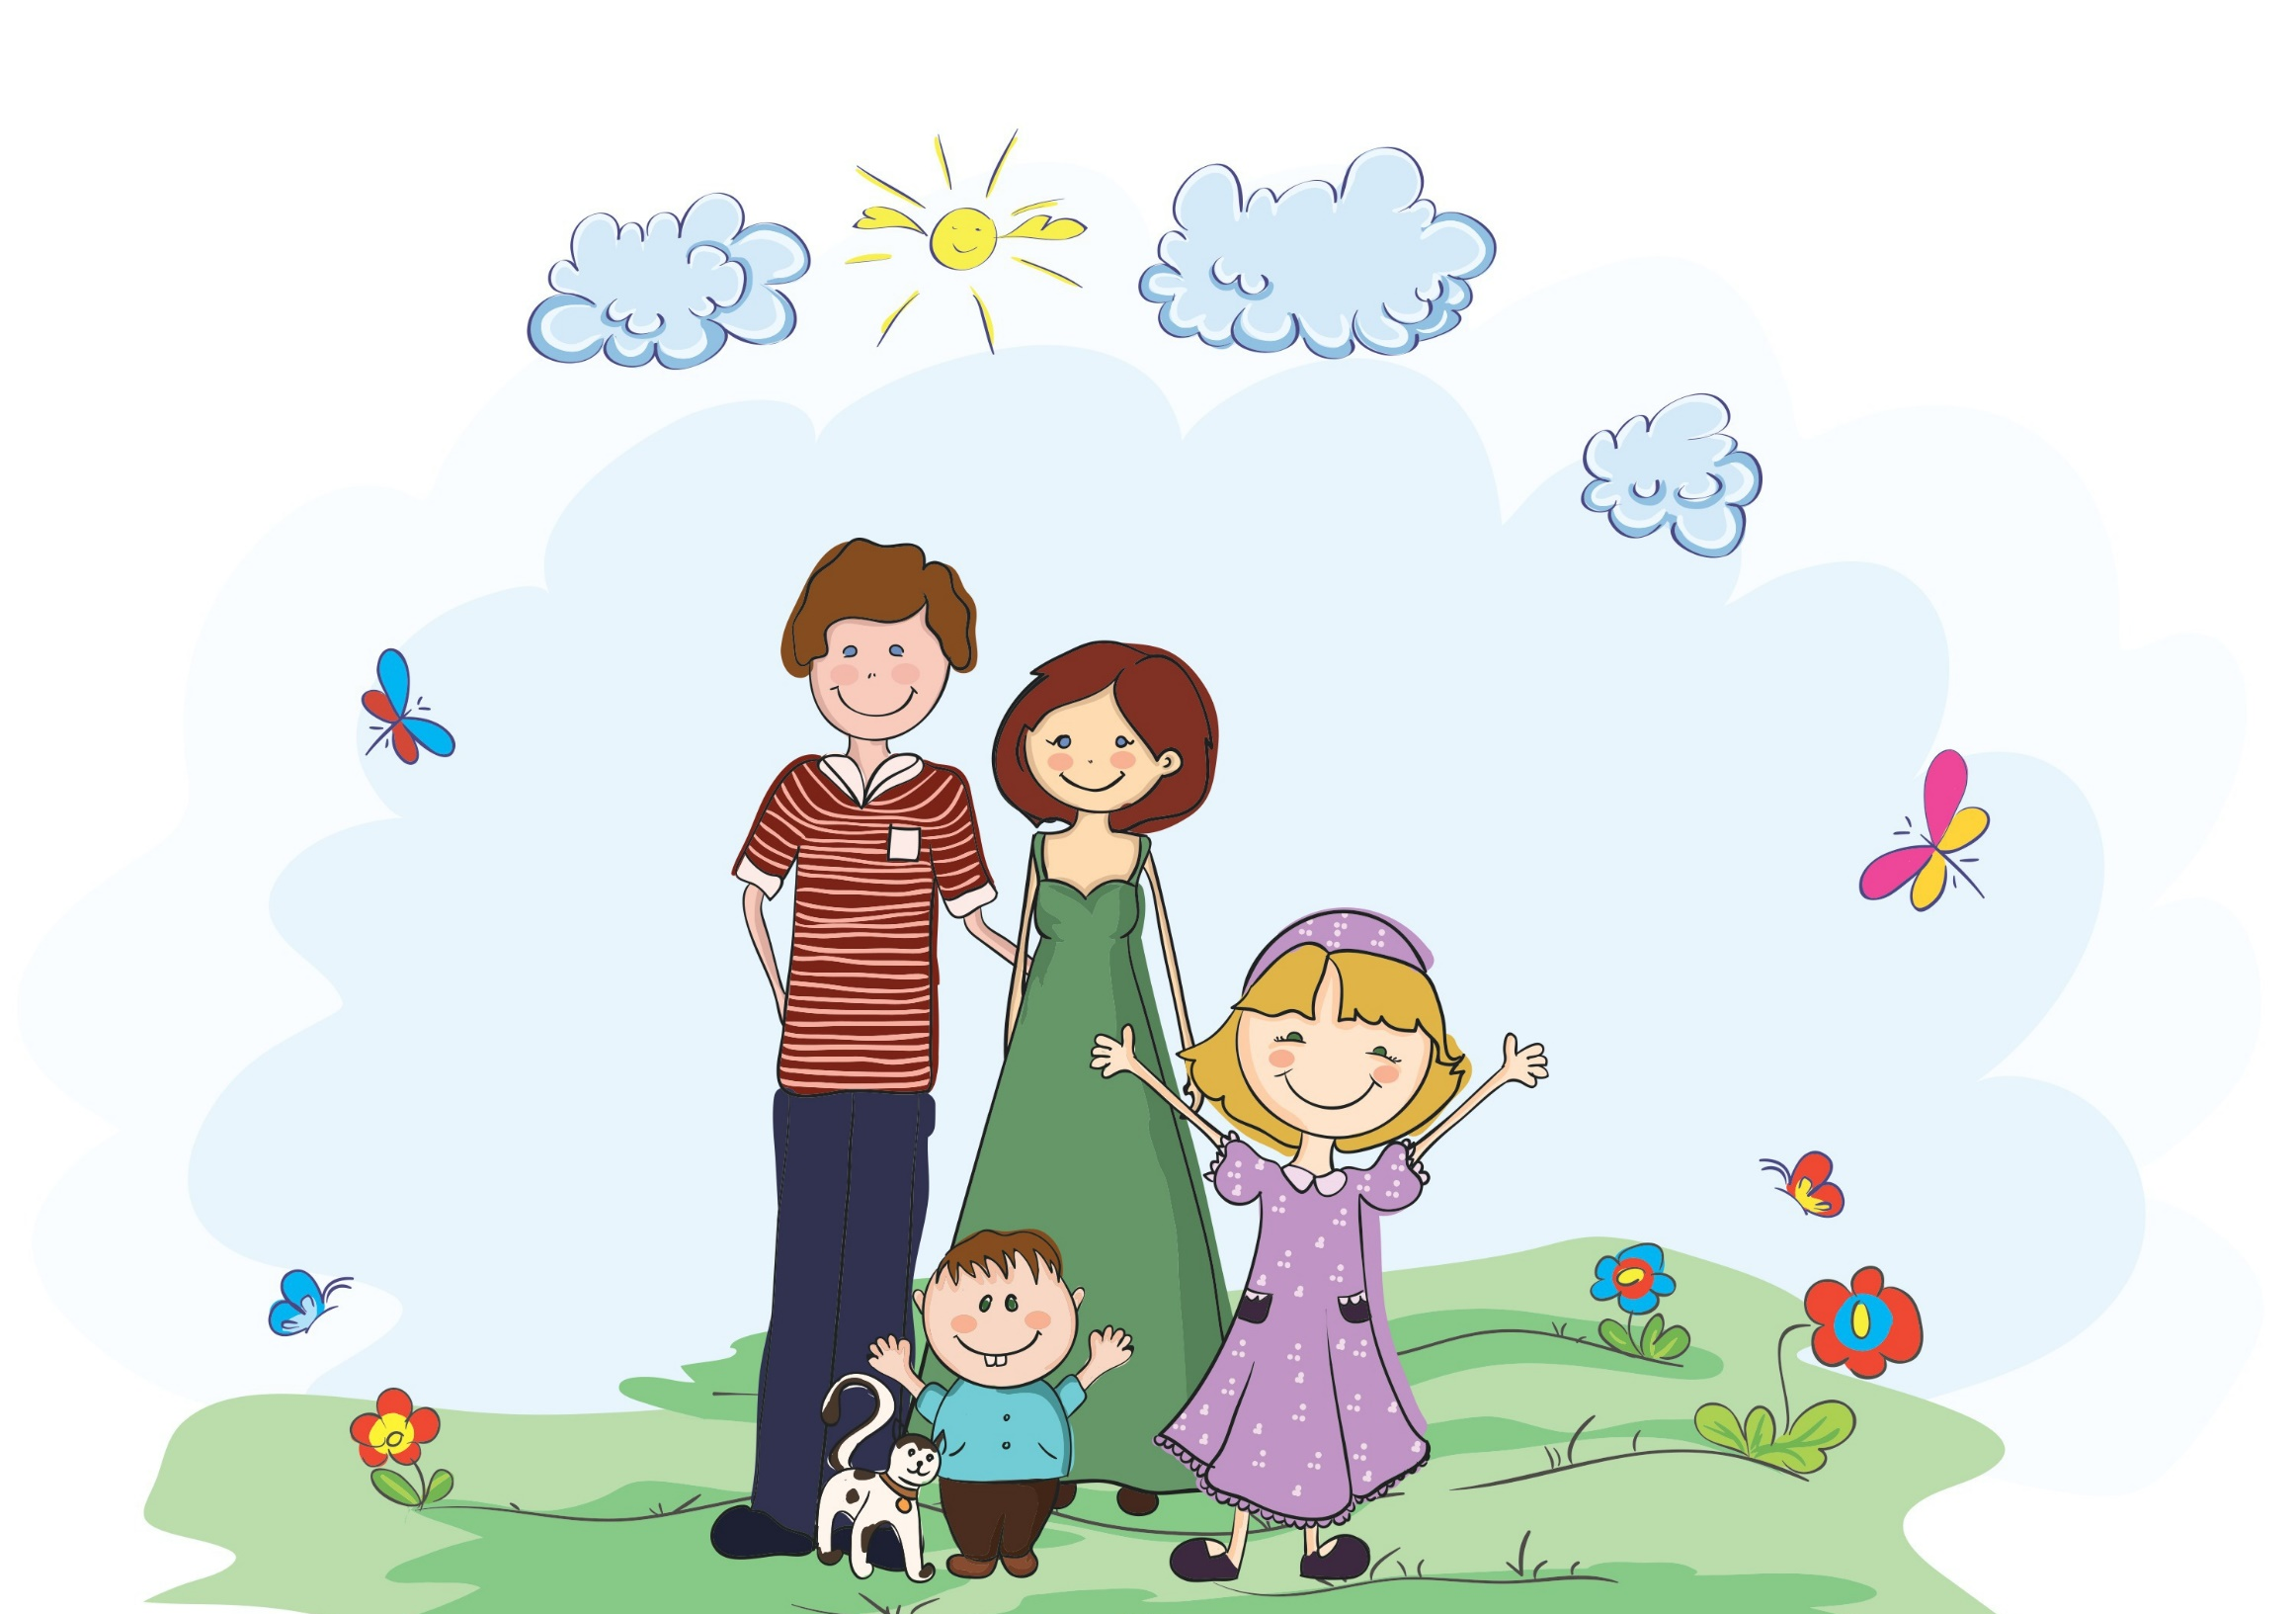
Safety Kids
and
Arizona Crime Prevention Association, Inc.
Copyright © 2015
All rights reserved.
www.safetykids.org
www.acpa.net

