Slide 1


SAFETYKIDS PROGRAM
Keeping children safe from abduction, violence, and exploitation! FEATURING CHARLIE CHECK FIRST

Slide 2

What is…Be a Safety Kid Program?
Is a fun, motivating, and effective way to teach personal safety to children.
Teaches children how to make wise choices and to be empowered to object to or avoid situations that are dangerous or harmful to their bodies.
A majority of the children who are victimized know the perpetrator; therefore, the concept of stranger danger is ineffective! It puts children in a position of feeling secure just because they think they know the person. This, in fact, makes them vulnerable and may lead to victimization.
Charlie Check-First replaces the stranger danger concept and has been readily endorsed by educators and law enforcement.

Slide 3
SAFETY EDUCATION – WHY TEACH IT?
Kids are not taught at home
Prepares children; gives them a plan
Parents don’t understand the need or importance
Empower children with knowledge
Children will not always be supervised
Children do not make good choices

Slide 4
SAFETY KIDS –
WHY A CERTIFICATION?
FINGERPRINT CLEARANCE
BACKGROUND CHECKS
CPR CERTIFIED
FIRST AID CERTIFIED
WATER SAFETY CERTIFIED
INFANT CARE CERTIFICATION
NANNY SKILLS CERTIFICATION
NUTITION AND HEALTH CERTIFICATION
OTHER PROFESSIONAL CERTIFICATIONS
So why not a
SAFETY KIDS CERTIFICATION?

Slide 5




Our Mascots have been designed to enhance the teachable moments, be memorable and fun.
Charlie Check-First teaches children to:
“Check First before you go anywhere with anyone.”
KC Koala reminds children that:
“Kind and Caring is the way to be!”
Ima S.T.A.R. says:
“Stand Together Act Responsible!”

Slide 6
WHO PRESENTS THE MATERIAL?
This curriculum has effectively been presented in many different ways, by many different professionals:
Classroom teachers present it as independent lessons.
Health teachers present it as part of the study on safety.
Guidance counselors present selected topics to the classrooms.
Public safety present the lessons in the classroom.
Teamwork is used (police officers + guidance counselors, etc.)
Self-defense instructors utilize the curriculum as a passive alternative.
Day cares, religious organizations and non-profits incorporate the curriculum concepts into other lessons or programs.

Slide 7
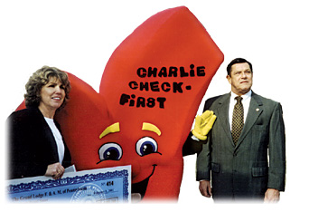
SAFETY KIDS HISTORY
Curriculum developed in 1998 involved teachers, counselors, psychologists in Pennsylvania.
Evaluated by Law Enforcement.
Diane L. Brown, founder and past director of safety kids retired in 2013.
A.C.P.A. took program in 2014 and spent 2 years evaluating and updating.
New website went live 2016 with updated and new content all in digital format.
DIANE L. BROWN, FOUNDER

Slide 8
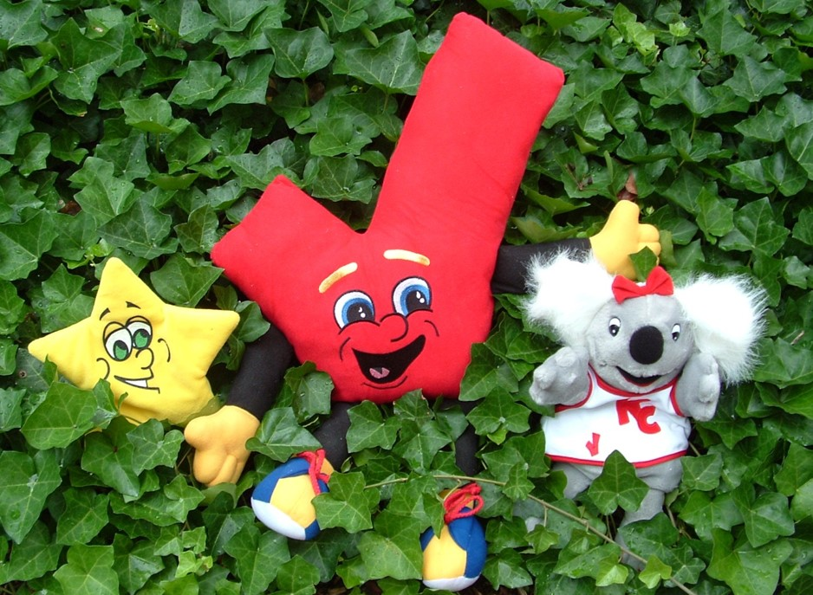
SAFETYKIDS PROGRAM
DIGITAL CONTENT-ONLINE CURRICULUM

Slide 9
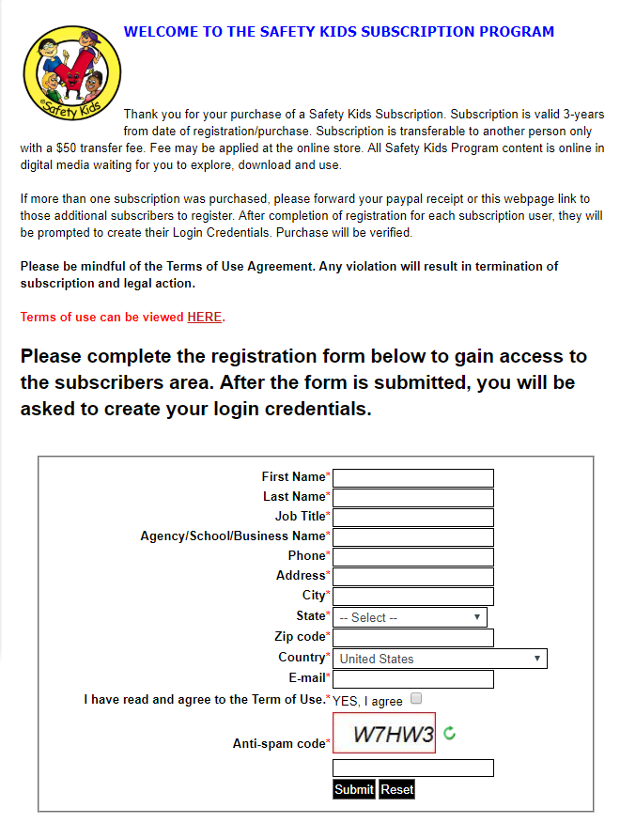
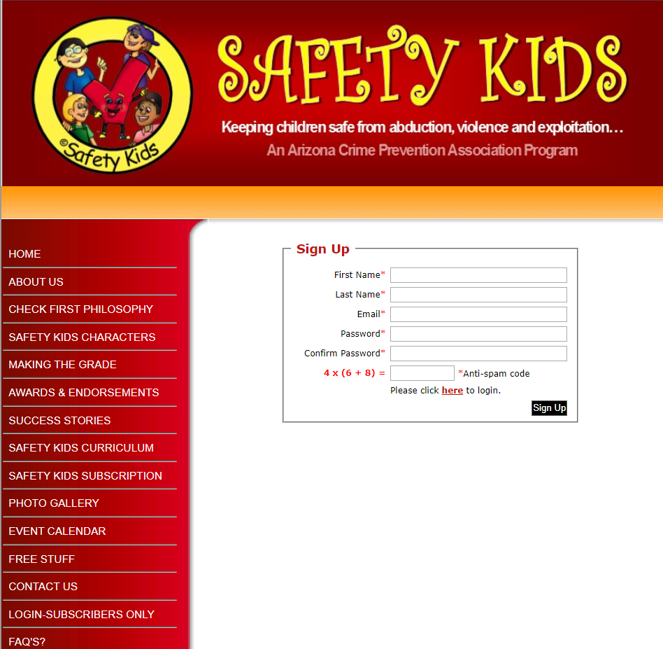

Slide 10
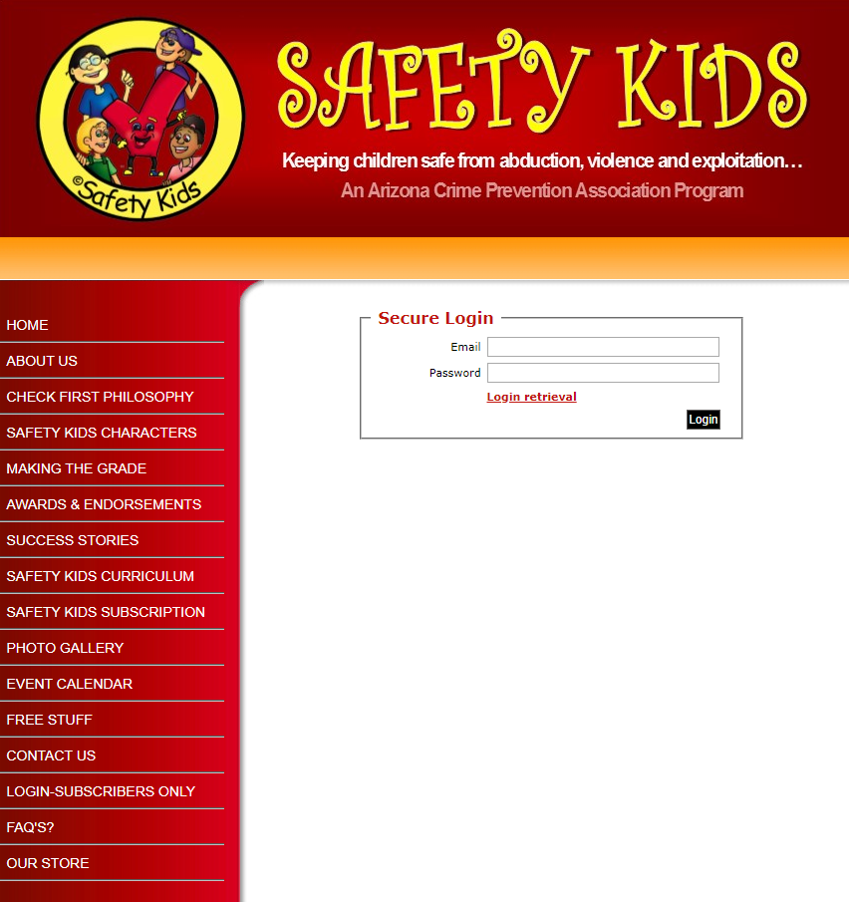
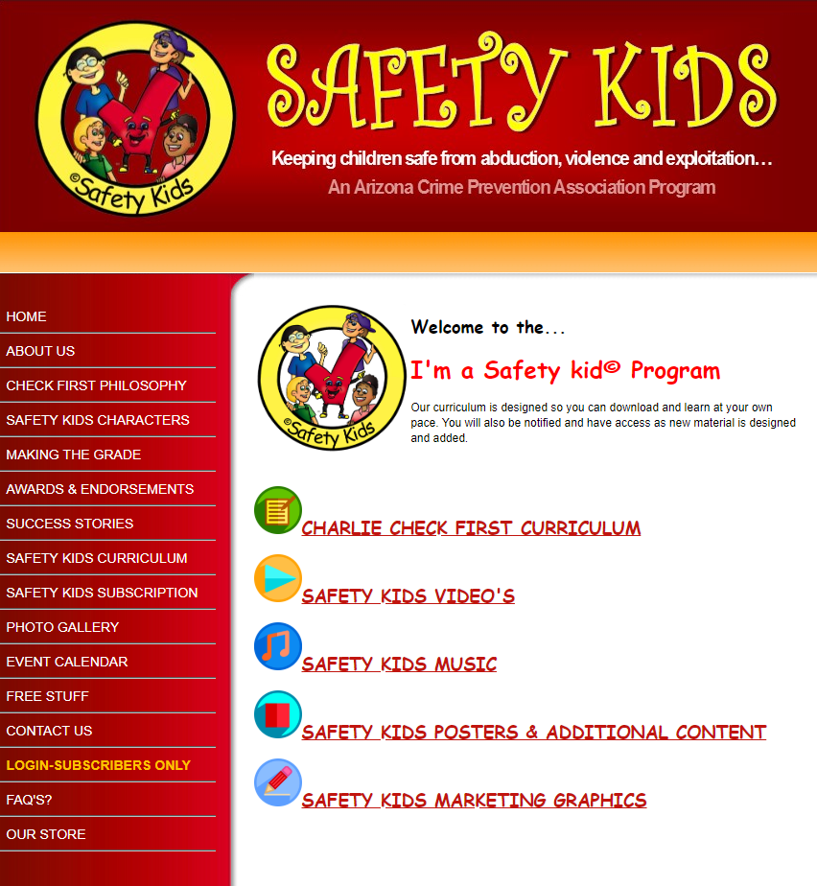

Slide 11
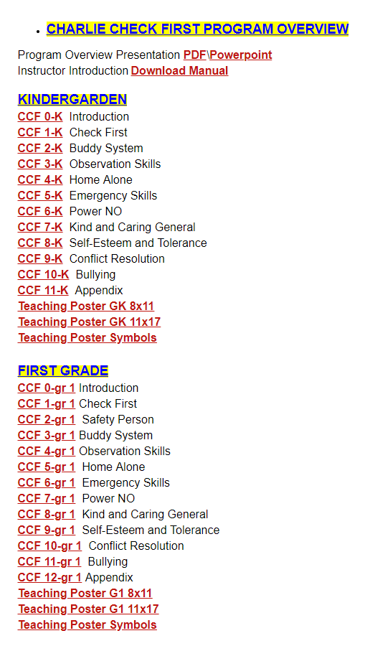
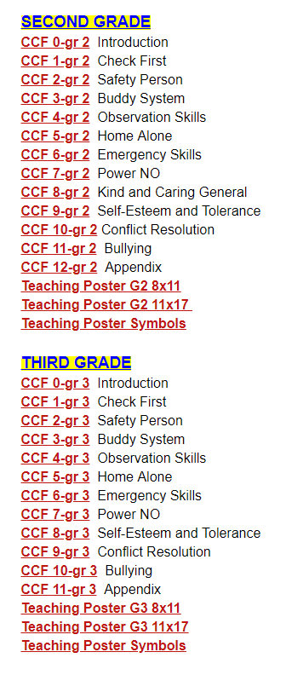
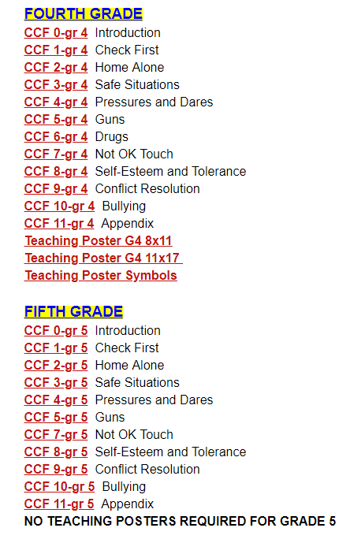
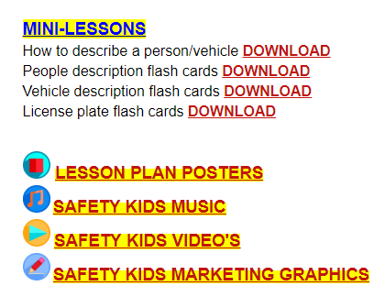

Slide 12
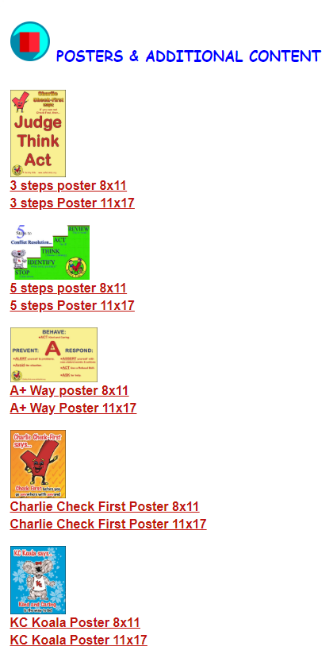
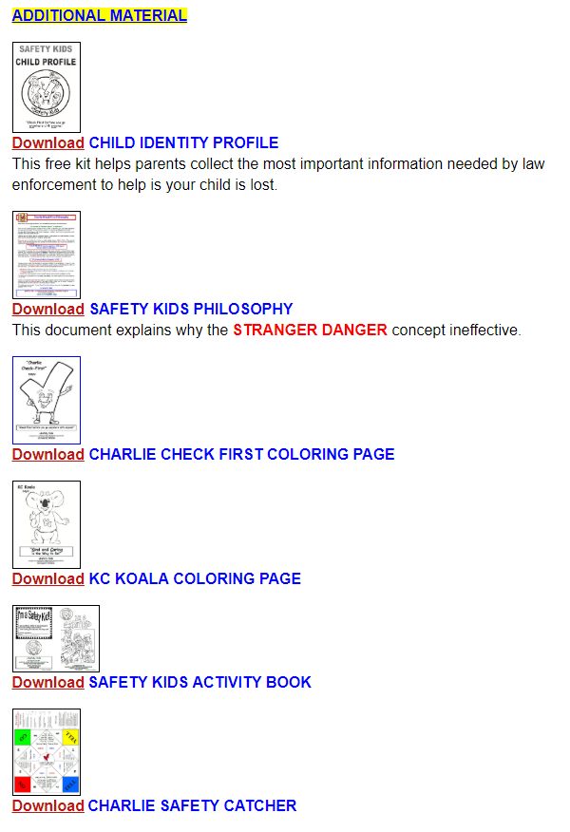
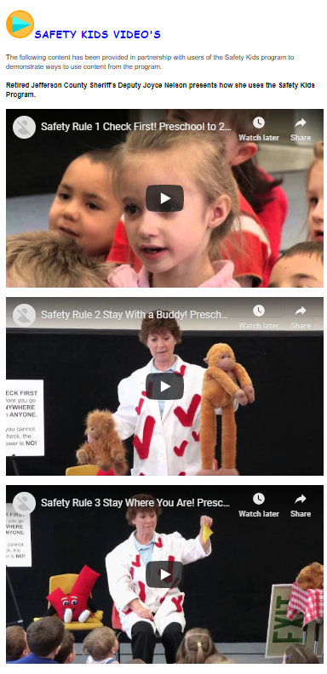
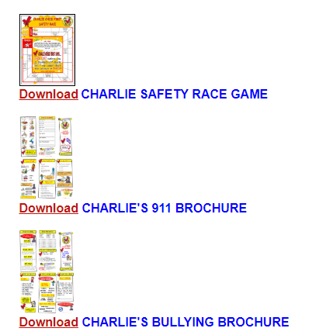

Slide 13
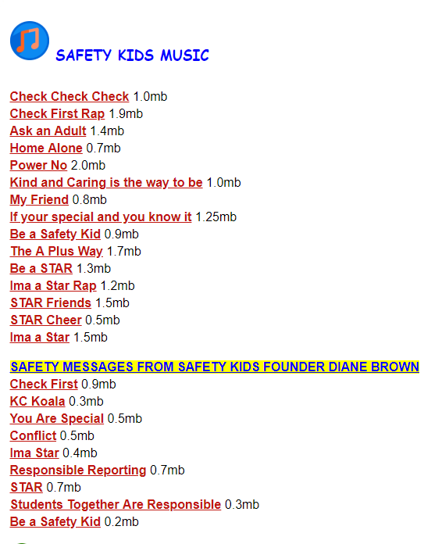
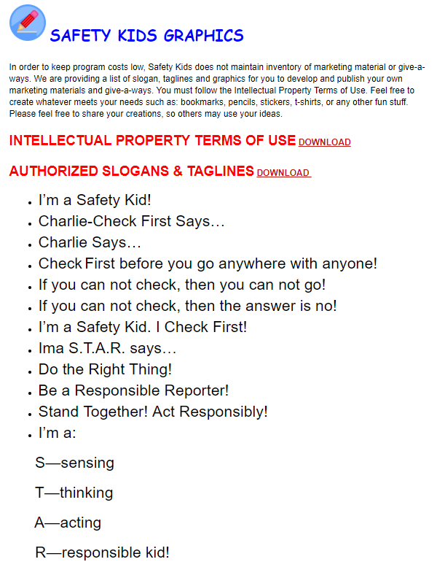
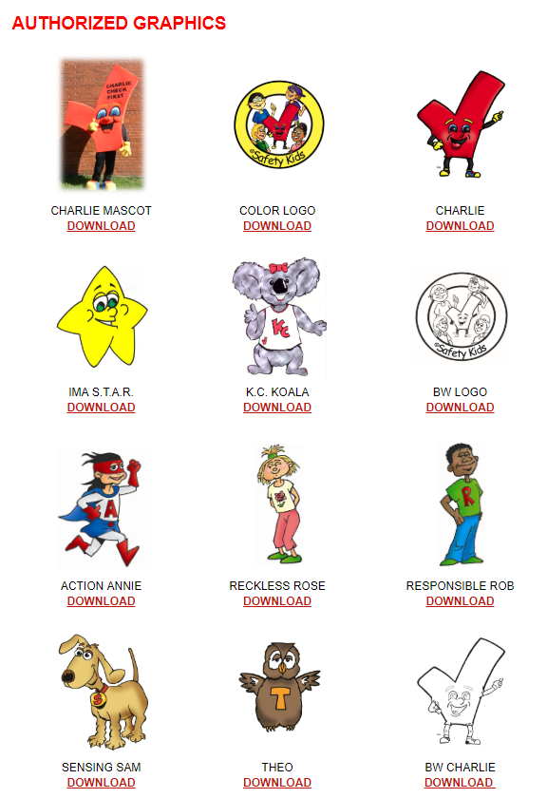

Slide 14
SAFETY KIDS PROGRAM
HOW TO USE CURRICULUM

Slide 15
HOW TO USE CURRICULUM
The curriculum structure is comprised of modular lessons, and they may be presented in three easy ways. With one exception, they may be taught in any order.
“Check First” is the most important topic and should be taught first.
1. Present one or two individual topics in a session, followed by a reinforcement activity
2. Present a general lesson that briefly covers many or all topics.
3. Mini-Lessons
The following are examples of Mini-Lessons: How to describe a person or vehicle; license plate, people or vehicle flash cards.
Notes:
Along with its effectiveness, the beauty of this program is its simplicity and flexibility.
1. This is the most beneficial teaching method and is ideal for the classroom teacher who can use the lessons, worksheets, and the reinforcement activities periodically through-out the year. Lessons and reinforcement activities should be spaced out to allow for gradual and consistent learning.
2. Choose the topics that are most important for you and the students. This often works best for the law enforcement officer or crime prevention practitioner who has limited time in the classroom. Ask the classroom teacher to follow up with reinforcement activities and worksheets.
3. Mini-Lessons are short lessons which only require a few minutes to teach. These are great for time fillers in the classroom, after school programs or the Law Enforcement Officer who only has a short time in the classroom or community event.

Slide 16


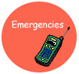



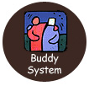
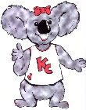

The curriculum is divided into core subjects which are age appropriate and designed with easy to follow script. Each core subject has follow-up activities designed to reinforce the concept of the lesson. These activities address Gardner’s “Multiple Intelligence Theory.”
 | LURES |  | SAFETY PERSON
 | EMERGENCIES |  | POWER NO
 | HOME ALONE |  | STAND TOGETHER, ACT RESPONSIBLY
 | BUDDY SYSTEM |  | KIND & CARING
 | OBSERVATIONS

Slide 17
SAFETY KIDS CURRICULUM CONTENT
Each lesson will follow the same format no matter the grade level with the exception of mini lessons.
Lessons - Easy to follow outline. Provides verbiage which can be read to the audience. Identifies which props to use and when to involve the students.
Introduction – Explains the lesson.
Materials – Items needed to present the lesson.
Objectives – What the students will learn, the goal or take-a-way.
Appendix - A variety of handouts and may include letters to parents, follow-up to lessons, certificates, and much more.

Slide 18

Gardner’s “Multiple Intelligence Theory.”
Children have the capacity to learn in different ways. What works best for one child may not be effective for another. Therefore, these activities address Gardner’s “Multiple Intelligence Theory” of visual learners, auditory learners, and kinesthetic learners.
The activities at the end of each topic are designed to reinforce the concepts of the lesson. It is most beneficial to do activities periodically, so that the safety tips are reinforced throughout the year.
The reinforcement activities are categorized in the following manner:
Intrapersonal
Interpersonal
Logical/Mathematical
Verbal/Linguistic
Musical/rhythmic
Visual/Spatial
Body/Kinesthetic
The activities are geared for a variety of age groups so that you can select or adapt them to meet the mental maturity of your students.

Slide 19
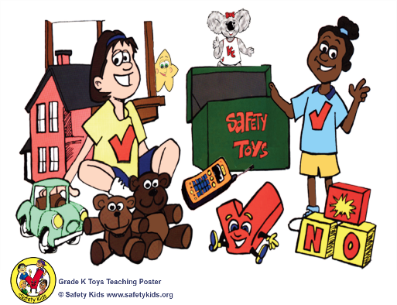
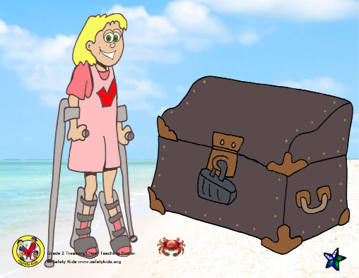
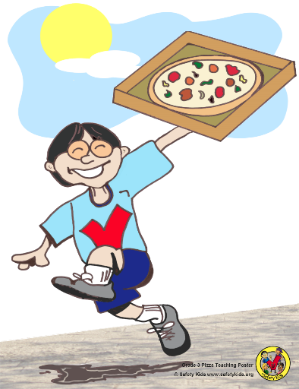
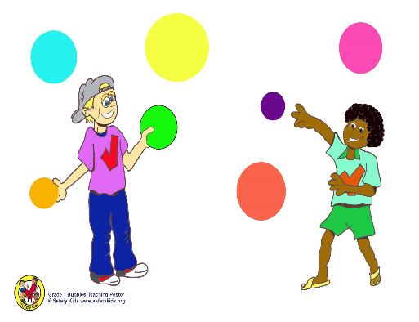
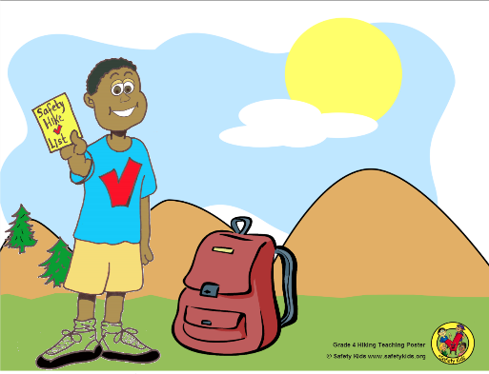
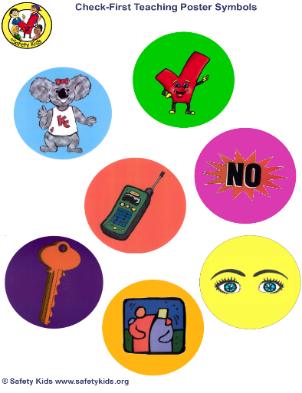

GRADE LEVEL
TEACHING POSTERS
Each grade level except for grade 5 has an associated poster to help teach the lessons. Although, the lessons can be taught without the posters. The teaching symbols can be cut out and laminated. Use Velcro or magnets to apply to posters. Be creative!
KINDERGARTEN
2ND GRADE
3RD GRADE
1ST GRADE
4TH GRADE
SYMBOLS

Slide 20
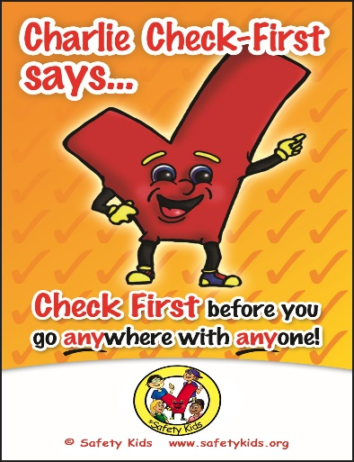

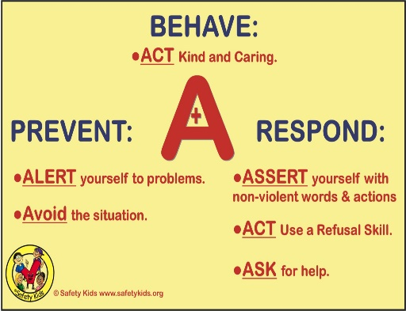
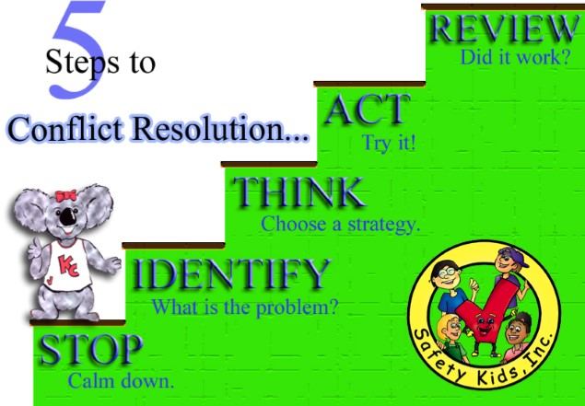


PROGRAM
POSTERS
Additional, these posters will aid in the delivery of the lessons in the curriculum.

Slide 21
HOW TO EVALUATE THE PROGRAM
The Pre/Post Evaluation is located in the introduction pages [CCF-0] for each grade level
Give your students the Pre/Post Evaluation prior to beginning the material. Read the questions for those students who need that assistance. Sometimes there are no right and wrong answers; it is mainly a question of what they perceive.
Give the same test to students after completing the lessons. Was there a change in their thinking? Do they now realize the safest response to a variety of situations?
The Pre/Post Evaluation may assist you in justifying the usage of this program in your teachings. It is also helpful in documenting the programs effectiveness and obtaining additional program licenses for others to use the program.

Slide 22
LESSON INTRODUCTION
Philosophy
Teaching Procedure / Poster Description
Reinforcement Activities
Pre/Post Evaluation

Slide 23
STARTING A SAFETY KIDS LESSON
Review the entire lesson to include: Introduction, lesson, and appendix.
Decide if you will utilize the pre and post test.
Gather the props needed to teach the lesson you have selected.

Slide 24
EXECUTING THE LESSON
The Pre K/Kindergarten lesson [CCF-1-K] is used for this demo.
Prepare your materials in the location the lesson will be taught to include:
Decide which topics you plan to teach for your session and have the corresponding symbol cards ready.
Toy chest poster, poster symbols [circles], and any props such as buddy bears or a poster of Charlie Check First.
Display the Toy Chest poster. Discuss the story behind the Safety Kid on the poster. [Follow script in lesson] “These kids are Safety Kids and they love to play with their safety toys.”
Remove a symbol card and discuss that topic.
For Example: If you selected the Charlie Symbol Card as the lesson, “Who can come up to the poster and point to a funny, little, red toy? He is a special friend of mine and I have him with me today. You can then display the Charlie Check First Poster Symbol or Charlie poster.

Slide 25

CHARLIE CHECK FIRST LESSON

Slide 26
CHECK FIRST TEACHING PROCEDURE
Materials Needed for Lessons
Charlie Check-First doll or poster
Toys or JUDGE, THINK, ACT poster
A decorated box or bag to be your Safety Toy Box
Assorted objects to put in Toy Box (some that represent the items on the poster [lesson topics] and some that do not)
Safety Kids Songs (optional)
Letter to the Parents/Guardian (Appendix)
Objectives for Students
Repeat the safety slogan: “Check First before you go anywhere with anyone.”
Name two people they can check with to make sure it is OK.
Give two examples of times they should Check First.
Recite the second part of the slogan: “If you cannot check, the answer is NO!”
State a safe response to the lure of a pet.
State a safe response to the lure of friendliness.
State a safe response to the lure of an emergency.
State a safe response to the lure of authority.
State a safe response to the lure of assistance.
State a safe response to the lure of bribes.

Slide 27

CHECK FIRST PHILOSOPHY
YOUNGER CHILDREN [PRE-K, K, 1ST and 2nd GRADES]
“Check First before you go anywhere with anyone (for any reason at any time).”
If you cannot check, the answer is NO!
OLDER CHILDREN [3rd GRADE AND OLDER]
Judge, Think, Act
Look at the whole situation.
Think carefully and evaluate everything.
Follow the Safety Kids’ rules.

Slide 28
CHECK FIRST INSTRUCTION
THE RULE
THE NEED TO CHECK
THE CHECK FIRST PHILOSOPHY
What does it mean to check?
Who can you check with?
If there is no way to check, the answer is NO!

Slide 29
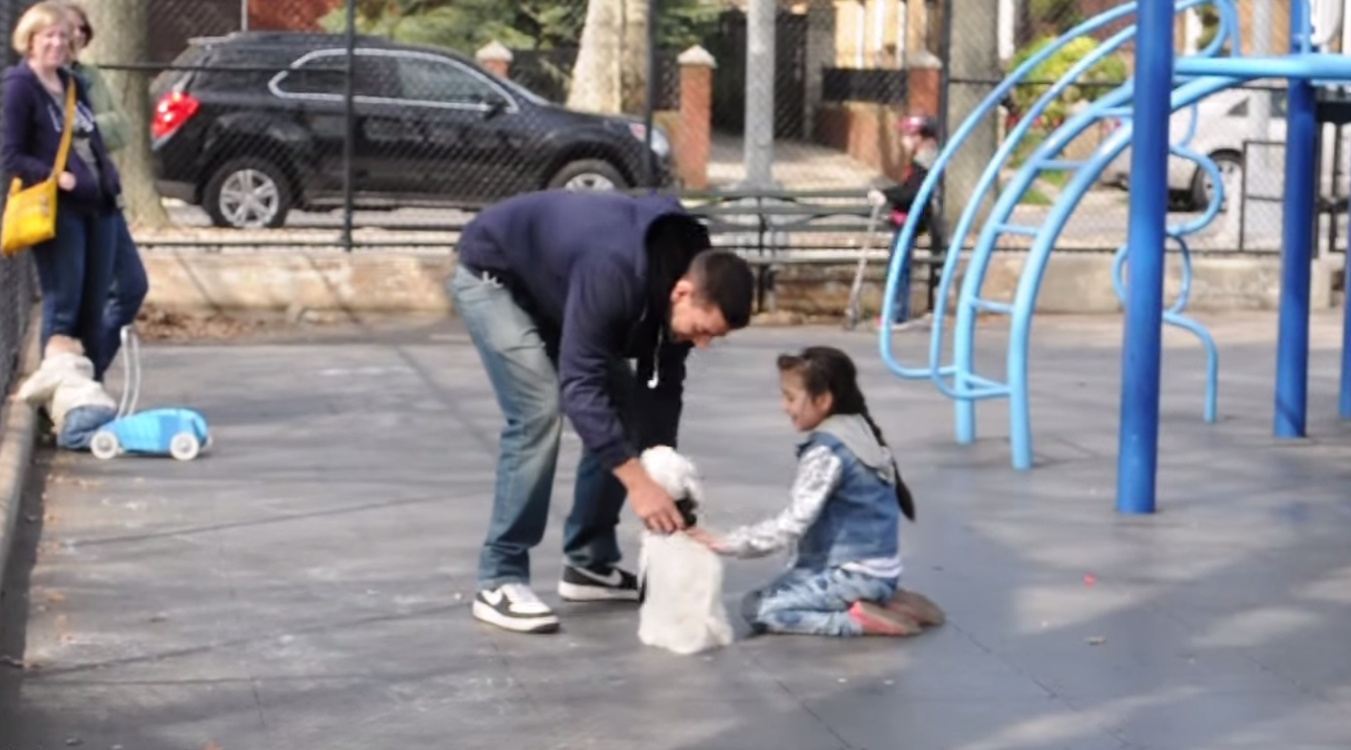
LURES USED TO ATTRACT CHILDREN
COMMON LURES
LOST PET
FRIENDLINESS
ASSISTANCE
BRIBES
EMERGENCY
AUTHORITY
Notes:
NOTE: To change images on this slide, select a picture and delete it. Then click the Insert Picture icon
in the placeholder to insert your own image.

Slide 30
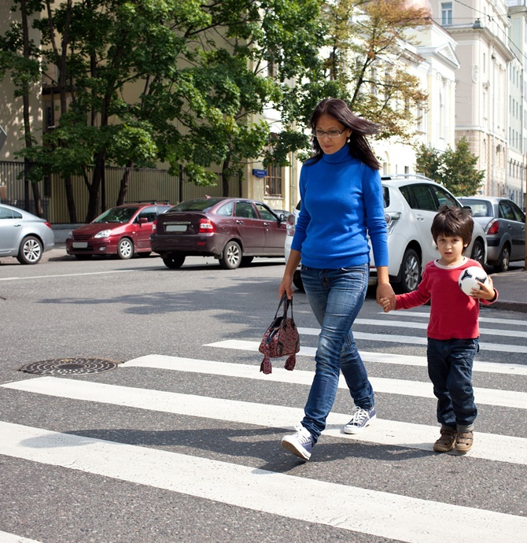
CHECK FIRST SAFETY PERSON
Parent Identifies
Someone trusted
No more than 3 safety persons
Code word used only for children older than 3rd grade

Slide 31
CHECK FIRST CLOSURE
Repeat the rule several times while holding up Charlie Check-First.
“Check First before you go anywhere with anyone.”
Repeat the second part of the rule several times while holding up Charlie Check-First.
“If you cannot check, the answer is NO!”
Use the Safety Kids Songs to reinforce the safety kids rules.
Use any of the follow-up material to reinforce the lessons and skills taught.

Slide 32

SAFETY PERSON/HOUSE LESSON

Slide 33
SAFETY PERSON/HOUSE
TEACHING PROCEDURE [1ST GRADE AND UP]
Materials Needed for Lessons
Charlie Check-First doll or poster
Toys poster
Bubbles poster
Safety Person / Safety House safety bubble card
Safety Kids Songs (optional)
Letter to the Parents/Guardian (Appendix)
Safety Person Letter (Appendix)
Objectives for Students
Realize that most people are good, kind, and helpful.
Explain how the Safety Person procedure works.
Establish a Safety House and a Safety Person with their mom and dad.
Recognize that a Safety Person is the only exception to Charlie Check-First’s rule.

Slide 34
SAFETY PERSON/HOUSE
INSTRUCTION
SAFETY HOUSE
SAFETY PERSON
A place for you to go when you need help is called a Safety House.
The person who lives in the Safety House is someone your parents trust, and you can go to them for help.
Your parent picks the Safety House.
The safety person is someone your parents trust and you can go to them for help.
You can take rides from this person, go in this person’s house, or ask them for help.
Code word used only for children older than 3rd grade.

Slide 35
SAFETY PERSON/HOUSE CLOSURE
Remember, a Safety Person is the only exception you are allowed to make to Charlie’s rule of checking first before you go with anyone.
A Safety Person and a Safety House are people and places that your parent chooses, not you. They will decide who is safe.
Be sure to make good decisions. It is a smart decision to Check First!
Use the Safety Kids Songs to reinforce the safety kids rules.
Use any of the follow-up material to reinforce the lessons and skills taught.

Slide 36
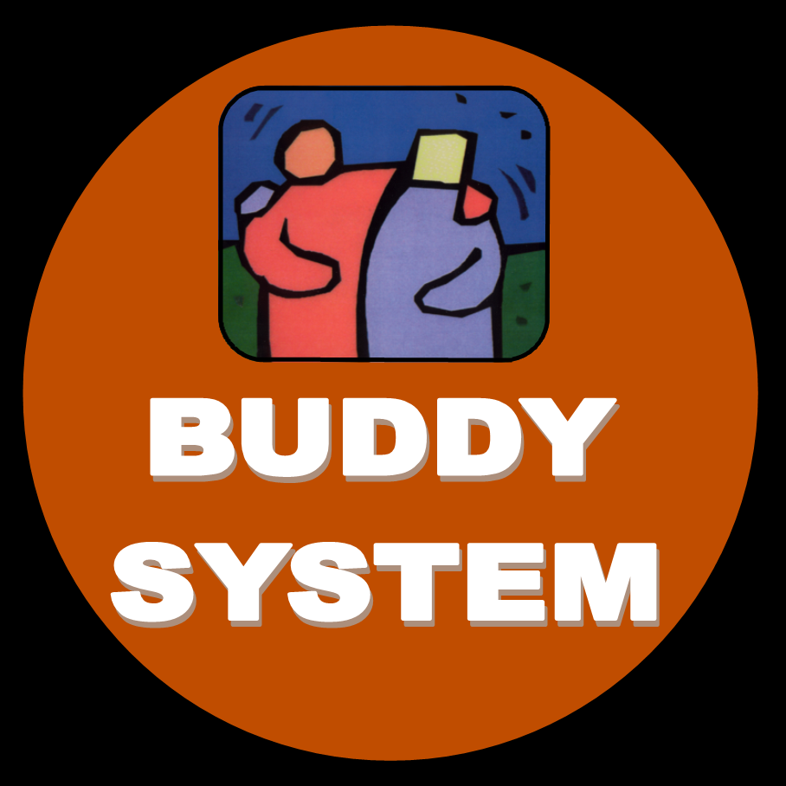
BUDDY SYSTEM LESSON

Slide 37
BUDDY SYSTEM TEACHING PROCEDURE
Materials Needed for Lessons
Charlie Check-First doll or poster
Toys poster
A decorated box or bag to be your Safety Toy Box
Assorted objects to put in Toy Box (some that represent the items on the poster [lesson topics] and some that do not)
Buddy Bears (or 2 stuffed animals or dolls)
Safety Kids Songs (optional)
Letter to the Parents/Guardian (Appendix)
Objectives for Students
State that a buddy is a friend or someone who is with you.
Name two times and places to have a buddy.
Participate in the “Freeze and Yell” technique.
Practice saying parents’ or guardians’ first and last names.

Slide 38
BUDDY SYSTEM INSTRUCTION
THE NEED FOR A BUDDY
FREEZE AND YELL
What is a buddy?
Who can be a buddy?
Having a buddy is safer.
When should you have a buddy?
What to do when you are separated from your buddy.
FREEZE “Put glue on your shoes!”
Learn the first and last name of their parent or guardian.

Slide 39
BUDDY SYSTEM CLOSURE
Before you walk around looking for someone, you need to remember Charlie Check-First’s rule:
“Check First before you go anywhere with anyone.”
If you cannot check, then you stay frozen in that spot. “Put glue on your shoes!”
Use the Safety Kids Songs to reinforce the safety kids rules.
Use any of the follow-up material to reinforce the lessons and skills taught.

Slide 40

OBSERVATION LESSON

Slide 41
OBSERVATION TEACHING PROCEDURE
Materials Needed for Lessons
Charlie Check-First doll or poster
Toys poster
A decorated box or bag to be your Safety Toy Box
Assorted objects to put in Toy Box (some that represent the items on the poster [lesson topics] and some that do not)
Toy car or toy figure of a person
Safety Kids Songs (optional)
Letter to the Parents/Guardian (Appendix)
Objectives for Students
Recite: “Be wise with your eyes.”
Practice taking two giant steps back away from a car or someone who approaches them.
Give a basic description of a car or person.

Slide 42
OBSERVATION INSTRUCTION
BE WISE WITH YOUR EYES
IF APPROACHED
What does it mean to be wise?
Tell trusted adult what happened.
Give details about person or vehicle.
Take two giant steps backwards.
Go in the opposite direction.
Find a trusted adult.

Slide 43
OBSERVATION CLOSURE
If approached,
  Take two giant steps backwards and go in the opposite direction.
How good were you at looking for details and remembering descriptions?
  Try to “Be wise with your eyes!”
You need to remember Charlie Check-First’s rule:
“Check First before you go anywhere with anyone.”
Use the Safety Kids Songs to reinforce the safety kids rules.
Use any of the follow-up material to reinforce the lessons and skills taught.

Slide 44
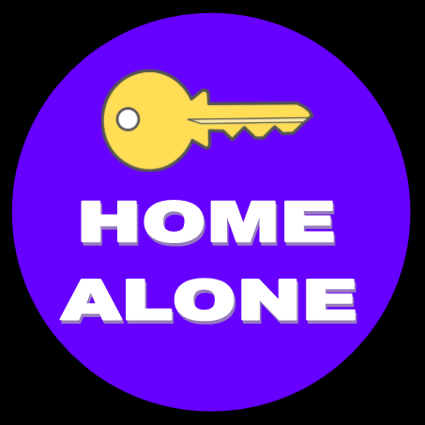
HOME ALONE LESSON

Slide 45
HOME ALONE TEACHING PROCEDURE
Materials Needed for Lessons
Charlie Check-First doll or poster
Toys poster
A decorated box or bag to be your Safety Toy Box
Assorted objects to put in Toy Box (some that represent the items on the poster [lesson topics] and some that do not)
A key
Toy phone or real phone
Safety Kids Songs (optional)
Letter to the Parents/Guardian (Appendix)
Objectives for Students
Use hand motions to recite: “Keep the door shut and locked!”
Role-play not answering the toy phone and letting it ring.
Explain what to do with someone at the door if the adult at home is busy or sleeping.

Slide 46
HOME ALONE INSTRUCTION
WHEN AT HOME
IF THE PHONE RINGS
What is a key?
Keeping the key secret.
Home alone, don’t tell.
Keep it SHUT and LOCKED!
What is a phone?
Let it ring, let it ring, let it ring.

Slide 47
HOME ALONE CLOSURE
Make sure each student can recite:
  “Keep the door shut and locked!” and
“Let it ring! Let it ring! Let it ring!”
Practice not answering on the toy phone.
You need to remember Charlie Check-First’s rule:
“Check First before you go anywhere with anyone.”
Use the Safety Kids Songs to reinforce the safety kids rules.
Use any of the follow-up material to reinforce the lessons and skills taught.

Slide 48
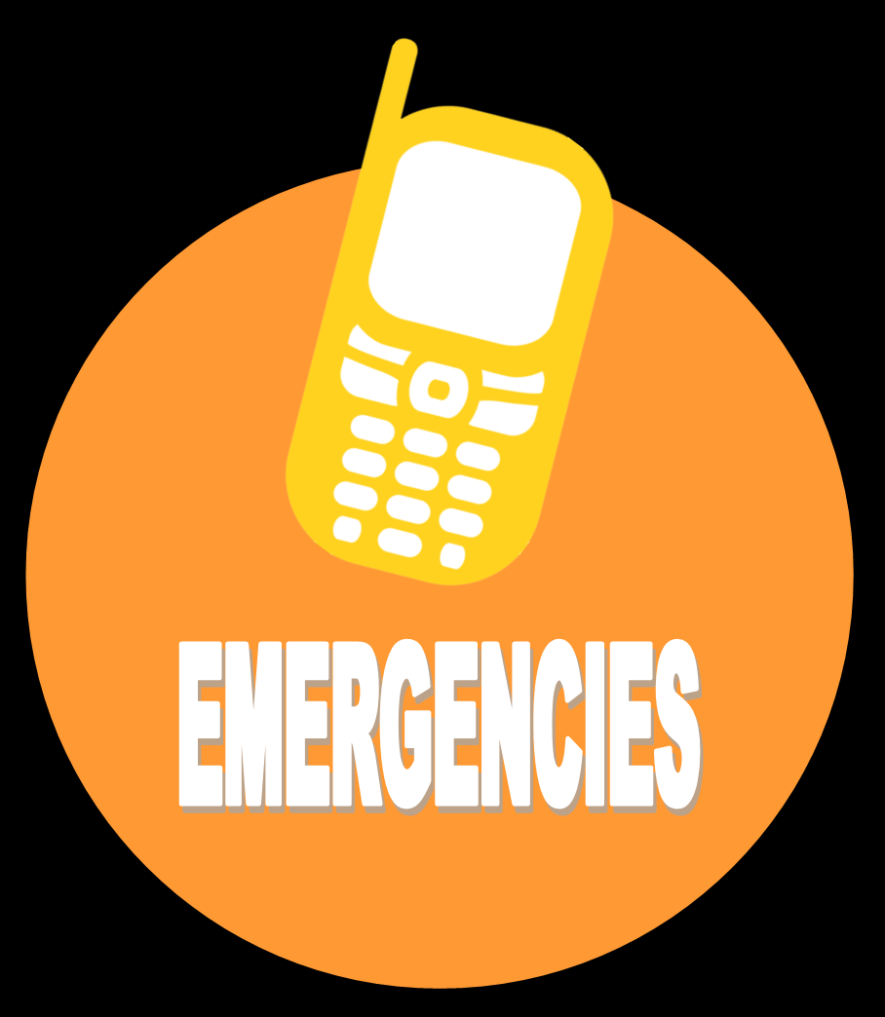
EMERGENCY LESSON

Slide 49
EMERGENCY TEACHING PROCEDURE
Materials Needed for Lessons
Charlie Check-First doll or poster
Toys poster
A decorated box or bag to be your Safety Toy Box
Assorted objects to put in Toy Box (some that represent the items on the poster [lesson topics] and some that do not)
Emergency Phone List (Appendix)
Toy phone or real phone
Check First 911 brochure
Safety Kids Songs (optional)
Letter to the Parents/Guardian (Appendix)
Objectives for Students
Explain the meaning of the word emergency.
Dial 911 and “0” on a toy phone.
Practice saying their phone numbers.
Identify an Emergency Phone List.

Slide 50
EMERGENCY INSTRUCTION
911 AND “0”
EMERGENCY PHONE LIST
What is an emergency?
How to turn phone on.
How to dial 911
What to tell operator to get help?
  [Name, phone number, location, emergency, their age.
What is my phone number.
List of numbers for emergency.

Slide 51
EMERGENCY CLOSURE
Use Charlie’s brochure, “How to dial 9-1-1”.
Use the Safety Kids Songs to reinforce the safety kids rules.
Use any of the follow-up material to reinforce the lessons and skills taught.

Slide 52

POWER NO LESSON

Slide 53
POWER NO TEACHING PROCEDURE
Materials Needed for Lessons
Charlie Check-First doll or poster
Toys poster
A decorated box or bag to be your Safety Toy Box
Assorted objects to put in Toy Box (some that represent the items on the poster [lesson topics] and some that do not)
Wooden blocks with the letters N and O; or cards with the letters N and O printed on them
Safety Kids Songs (optional)
Letter to the Parents/Guardian (Appendix)
Objectives for Students
Name the three steps in the Power NO.
State one good time to use the Power NO.
Explain what to do if someone tries to make them go somewhere against their wishes.

Slide 54
POWER NO INSTRUCTION
WRONG, UNSAFE OR HARMFUL
NO - GO - TELL
If it is wrong, unsafe, or harmful to you, then you need to use the Power NO.
Not OK touch. [SENSITIVE TOPIC]
If someone grabs you.
There are 3 steps for the Power NO:
Say NO.
Get away from the situation.
Tell an adult.

Slide 55
POWER NO CLOSURE
Review the three steps for the Power NO: NO! GO! TELL!
1. Say NO. 2. Get away from the situation. 3. Tell an adult.
Be sure to make good decisions. It is a smart decision to Check First! If you cannot check, be sure to say NO. The Power NO can help you!
Use the Safety Kids Songs to reinforce the safety kids rules.
Use any of the follow-up material to reinforce the lessons and skills taught.

Slide 56

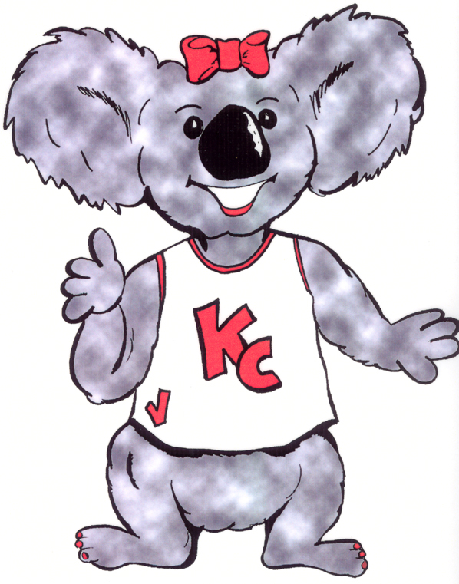
KIND & CARING LESSON
KIND & CARING

Slide 57
KIND & CARING TEACHING PROCEDURE
Materials Needed for Lessons
Charlie Check-First doll or poster
KC Koala doll or poster
Toys poster
A decorated box or bag to be your Safety Toy Box
Assorted objects to put in Toy Box (some that represent the items on the poster [lesson topics] and some that do not)
Safety Kids Songs (optional)
Letter to the Parents/Guardian (Appendix)
Objectives for Students
Identify KC Koala.
State the slogan, “Kind and Caring is the way to be!”
Explain the meaning of kind and caring.
Give one example of an act of kindness.

Slide 58
KIND & CARING INSTRUCTION
“Kind and Caring is the way to be!”
ACTS OF KINDNESS
Who is K.C. KOALA?
What does it mean to be kind?
What does it mean to be caring?
Share when you were kind or caring.
Share when someone was kind or caring to you.
Repeat: Kind and caring is the way to be!

Slide 59
KIND & CARING CLOSURE
Not only is it important to be kind to others, it is also more fun! You will have more friends and enjoy everything a whole lot more if you are kind and caring to others.
Repeat the slogan several times. “Kind and Caring is the way to be!”
Use the Safety Kids Songs to reinforce the safety kids rules.
Use any of the follow-up material to reinforce the lessons and skills taught.

Slide 60
KIND & CARING LESSON
Self-Esteem & Tolerance
KIND & CARING

Slide 61
Self-Esteem & Tolerance
KIND & CARING TEACHING PROCEDURE
Materials Needed for Lessons
Charlie Check-First doll or poster
KC Koala doll or poster
Toys poster
A decorated box or bag to be your Safety Toy Box
Assorted objects to put in Toy Box (some that represent the items on the poster [lesson topics] and some that do not)
A mirror
Safety Kids Songs (optional)
Letter to the Parents/Guardian (Appendix)
Objectives for Students
Discuss and discover two differences between children in the class.
Identify a reason why “I like myself.”
Name one thing that makes them special.
Name one thing that makes someone else special.

Slide 62
Self-Esteem & Tolerance
KIND & CARING INSTRUCTION
YOU ARE SPECIAL
DIFFERENCES
What does it mean to be special?
You are special by the way you look.
You are special by what's inside you.
Everyone is different!
Individuality and uniqueness.
What do you like about yourself?
Accept people the way they are.
Recognize and respect differences.

Slide 63
Self-Esteem & Tolerance
KIND & CARING CLOSURE
We need to respect each other and understand that everyone is different.
Allow time for a discussion.
This is the time to stress how individuality and uniqueness are important.
Every child has value and worth! We need to respect others! Stress this.
What makes KC Koala special? What makes these Safety Kids special?
Use the Safety Kids Songs to reinforce the safety kids rules.
Use any of the follow-up material to reinforce the lessons and skills taught.

Slide 64
KIND & CARING LESSON
Conflict Resolution
KIND & CARING

Slide 65
Conflict Resolution
KIND & CARING TEACHING PROCEDURE
Materials Needed for Lessons
Charlie Check-First doll or poster
KC Koala doll or poster
Toys and 5 STEPS poster
A decorated box or bag to be your Safety Toy Box
Assorted objects to put in Toy Box (some that represent the items on the poster [lesson topics] and some that do not)
Safety Kids Songs (optional)
Letter to the Parents/Guardian (Appendix)
Objectives for Students
State the slogan, “Kind and Caring is the Way to Be!”
Repeat the 5 steps to resolve a conflict.
Name something to do in order to calm down.
Explain one strategy to resolve a conflict.

Slide 66
Conflict Resolution
KIND & CARING INSTRUCTION
Lesson A
Introduction and Anger Management
Lesson B
Identify and Think
What is conflict?
What to do when there is conflict.
There are 5 steps to take to solve a problem or conflict.
    Step 1 is STOP.
    Step 2 is IDENTIFY.
    Step 3 is THINK.
    Step 4 is ACT.
    Step 5 is REVIEW.
  What does STOP mean?
What does IDENTIFY mean?
Short stories to identify the conflict.
Let’s THINK about what to do.

Slide 67
Conflict Resolution
KIND & CARING INSTRUCTION
Lesson C
Act and Review
What does ACT mean?
Tell me a plan you could use on the story I told you.
What does REVIEW mean?
Did it fix the problem?

Slide 68
Conflict Resolution
KIND & CARING CLOSURE
When you review what you have done, think about whether or not you were Kind and Caring to the other person. Were you a good friend to him or to her?
Let’s go over the 5 steps to resolving conflicts.
  STOP
  IDENTIFY
  THINK
  ACT
  REVIEW
Solve your problems in a peaceful way and you will be a Kind and Caring Kid!
Use the Safety Kids Songs to reinforce the safety kids rules.
Use any of the follow-up material to reinforce the lessons and skills taught.

Slide 69
KIND & CARING LESSON
Bullying
KIND & CARING

Slide 70
Bullying
KIND & CARING TEACHING PROCEDURE
Materials Needed for Lessons
Charlie Check-First doll or poster
KC Koala doll or poster
Toys and A+ Way poster
Check First Bully Brochure
A decorated box or bag to be your Safety Toy Box
Assorted objects to put in Toy Box (some that represent the items on the poster [lesson topics] and some that do not)
Safety Kids Songs (optional)
Letter to the Parents/Guardian (Appendix)
Objectives for Students
State the slogan, “Kind and Caring is the way to be.”
Identify one quality of a Kind and Caring Kid.
State a positive way to respond if someone is not kind and caring.
Demonstrate how acting kind and caring works in a bully situation.

Slide 71
Bullying
KIND & CARING INSTRUCTION
A+ WAY
Behavior: How not to be a bully.
  ACT Kind and Caring.
Prevention: How to prevent a bullying situation.
  ALERT yourself to what is going on around you. Are there possible problems ahead?
  AVOID potential bullying situations if possible.
Response: How to respond if you encounter a bullying situation.
  ASSERT yourself with strong, but non-violent, words and bodies.
  ACT (Be Kind and Caring. Use a Refusal Skill)
  ASK for help.

Slide 72
Bullying
KIND & CARING CLOSURE
Remember, you should try to be a Kind and Caring Kid toward others all of the time. It is sometimes hard, but really try to be nice and kind when someone else is mean to you. It is better to do that than to have hard feelings and get mad and maybe hurt someone.
What does KC say? Allow time for students to repeat the slogan.
  Kind and Caring is the way to be!
Use the Safety Kids Songs to reinforce the safety kids rules.
Use any of the follow-up material to reinforce the lessons and skills taught.

Slide 73
APPENDIX
Basic Safety Concepts
Safety Scenarios
Safety Check-Points for Kids
Safety Check Points for Parents
Emergency Phone List
Dear Parent or Guardian
Safety Kid Certificate
Safety Kid Coupons
Safety Kids Song Lyrics

Slide 74
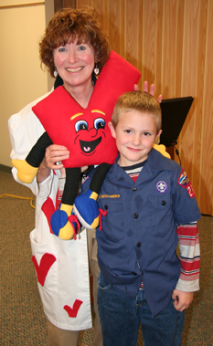
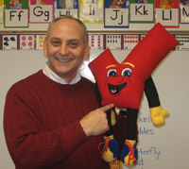
BRUCE WALL
JOYCE NELSON
Notes:
NOTE: To change images on this slide, select a picture and delete it. Then click the Insert Picture icon
in the placeholder to insert your own image.

Slide 75
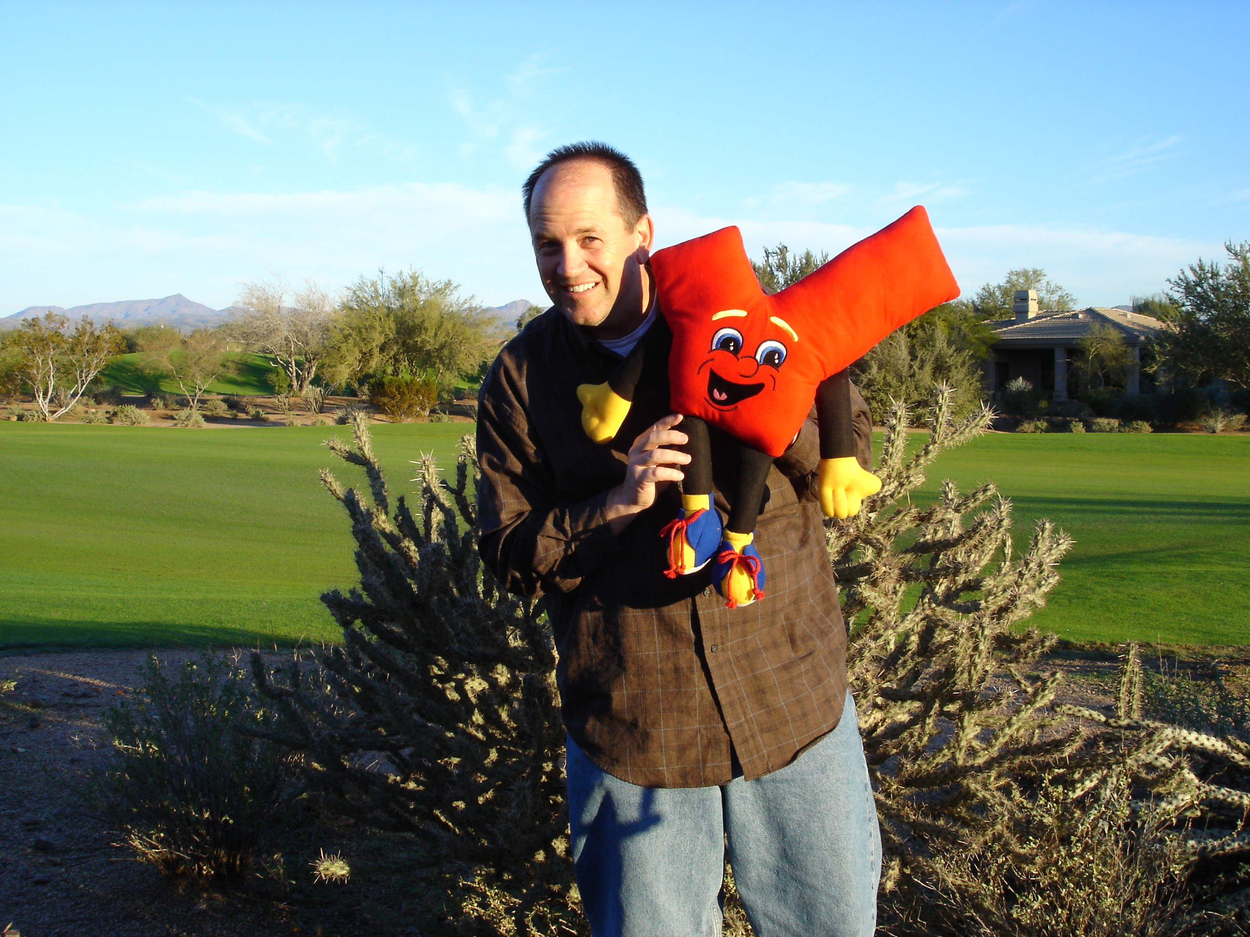
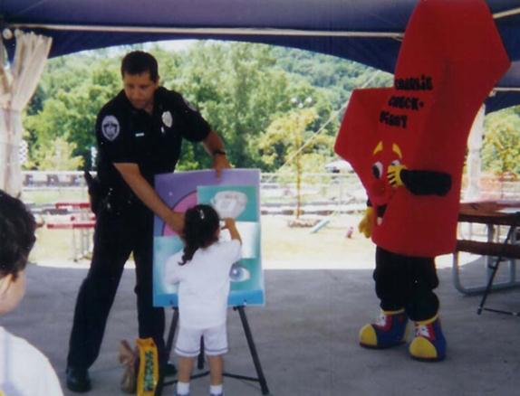
DIANE BROWN, FOUNDER
SCOTT REED
UNKNOWN OFFICER
Notes:
NOTE: To change images on this slide, select a picture and delete it. Then click the Insert Picture icon
in the placeholder to insert your own image.

Slide 76
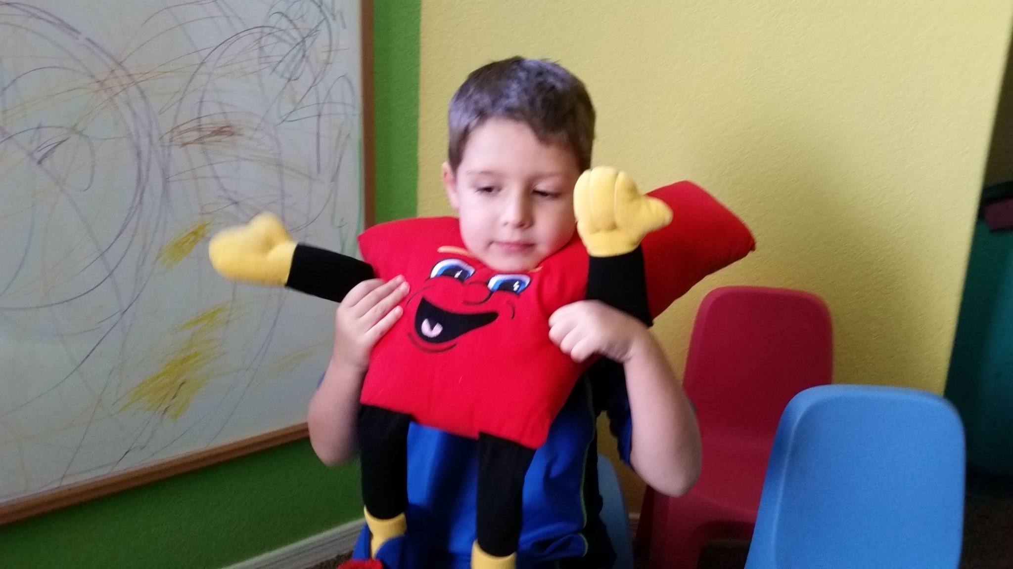
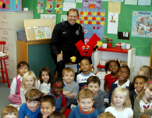
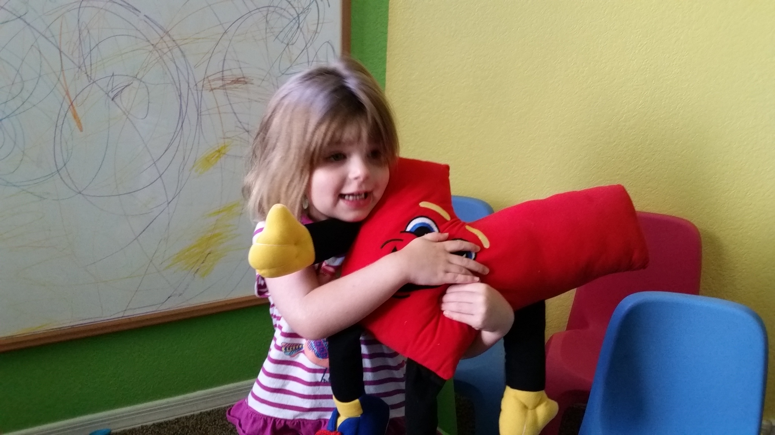
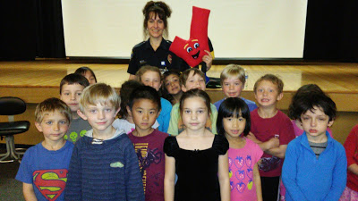
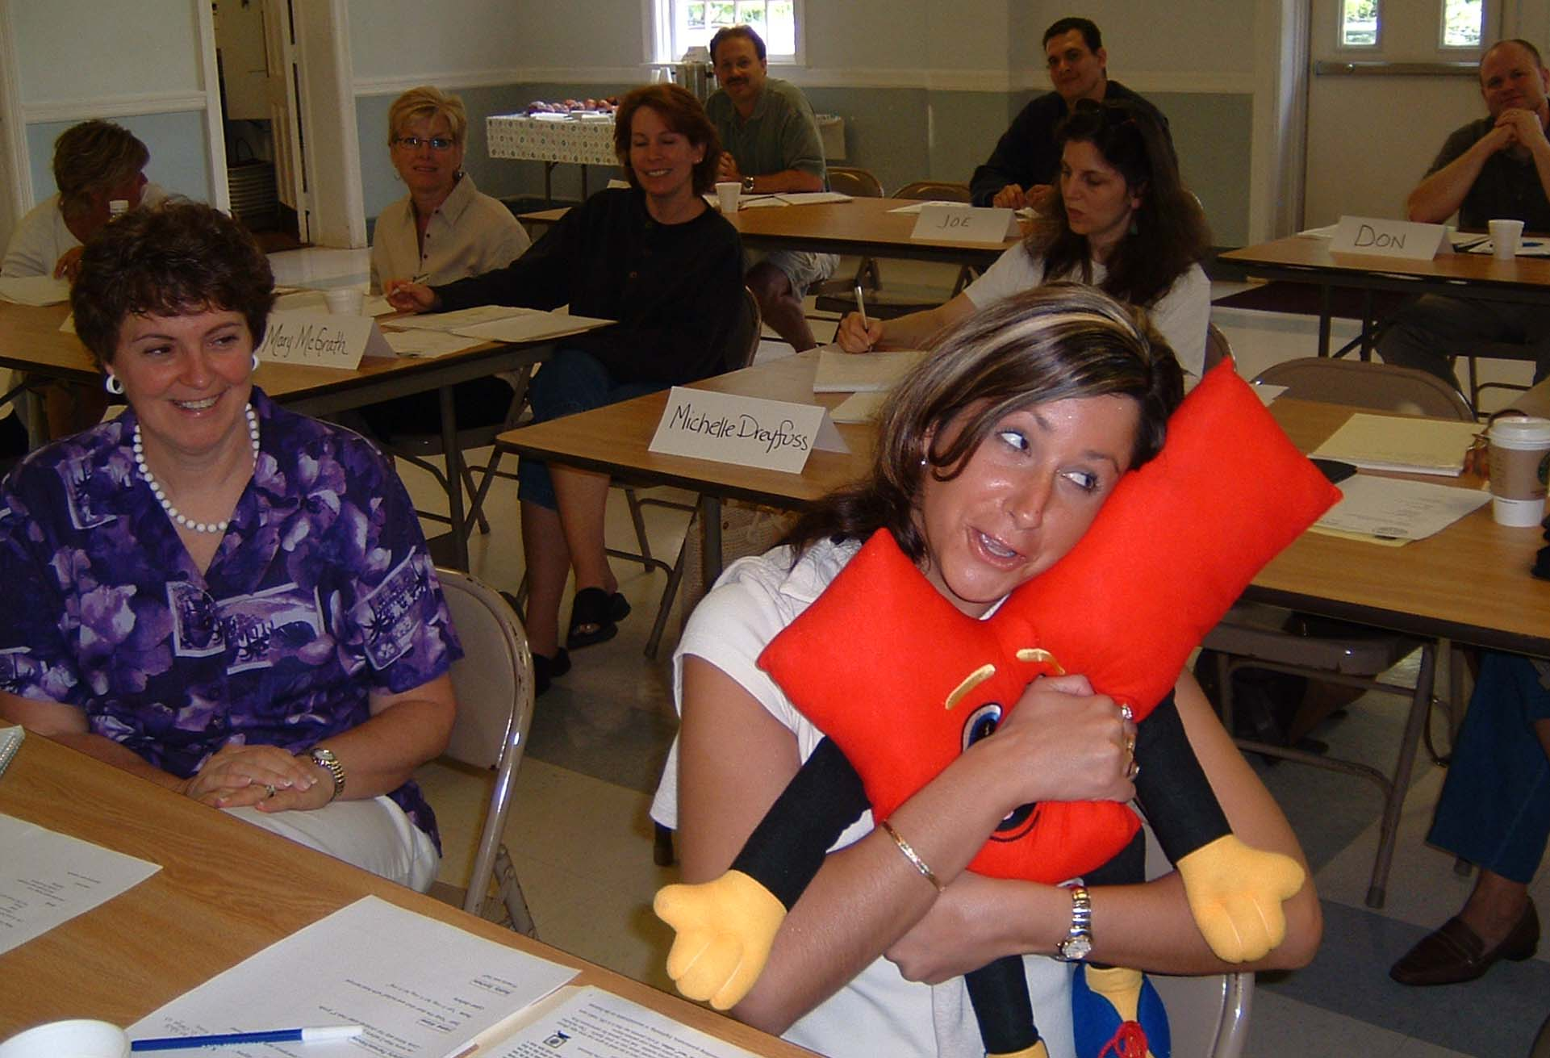
Notes:
NOTE: To change images on this slide, select a picture and delete it. Then click the Insert Picture icon
in the placeholder to insert your own image.

Slide 77
CHARLIE SAYS, “THANK YOU”
©Safety Kids
A program from the
ARIZONA CRIME PREVENTION ASSOCIATION
a 501(c)3 non-profit organization
www.safetykids.org
www.acpa.net

